Slide 1
Web Development
Arijit Chatterjee

Slide 2




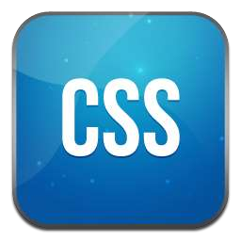

Front-end

Slide 3




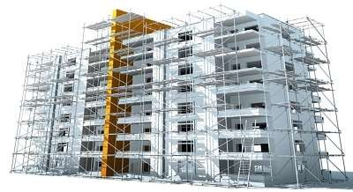
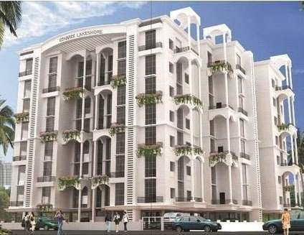

Three layers of web design:
Structure
HTML markup
Style
CSS
Behavior
JavaScript

Slide 4

HTML =
Hyper Text Markup Language

Slide 5

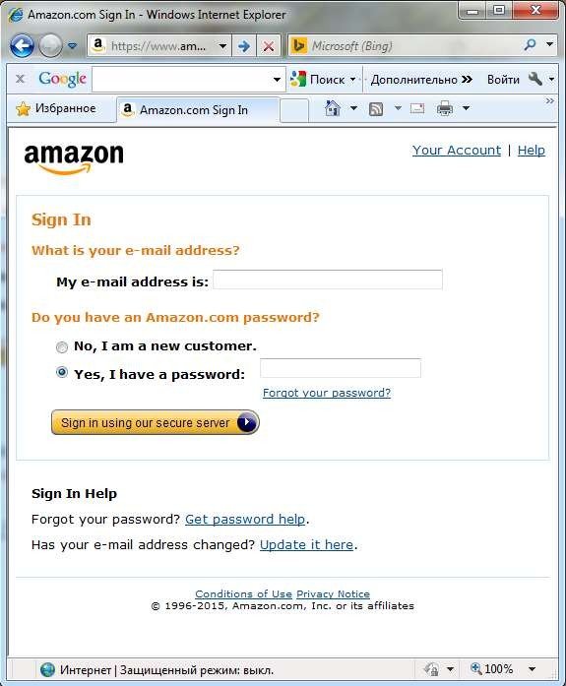

Do you imagine how this page would look like without HTML?

Slide 6

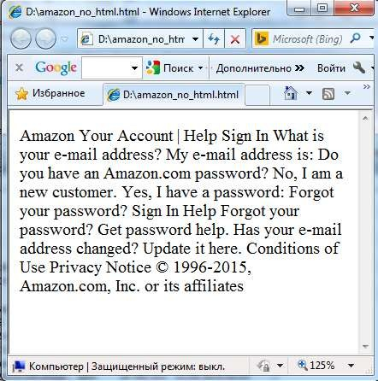

Looks ugly… Doesn’t it?

Slide 7

HTML tags give
structure
and
meaning
to your content.

Slide 8

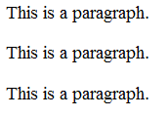
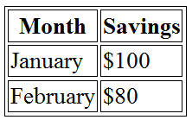
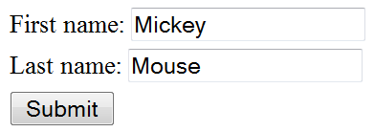

HTML Tags
<p></p> - to organize text into paragraphs
<table></table> - to display table
<form></form> - to define form for user input
<img></img> - to add image

Slide 9

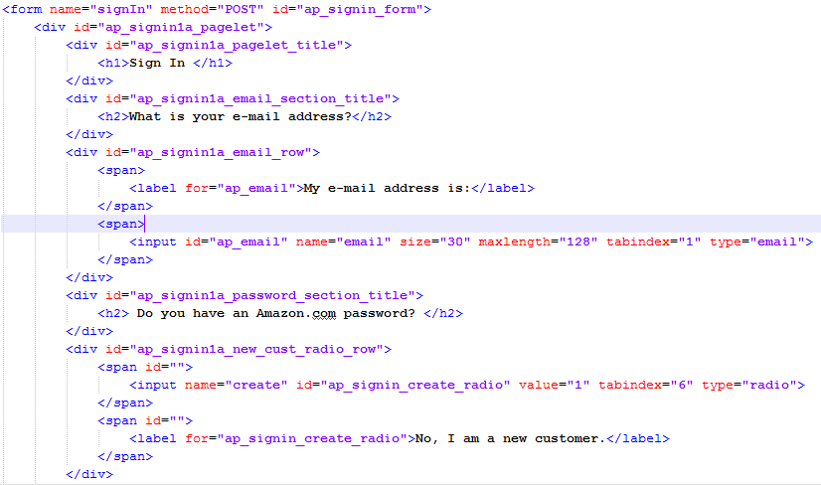
Lets add HTML tags to our page...
How will it look now?

Slide 10

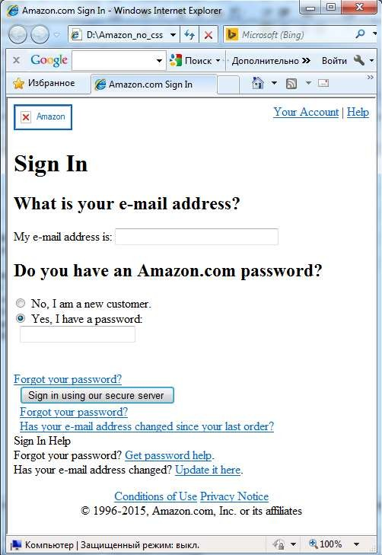

Looks better… But still not good…

Slide 11

HTML
Once page content is marked up with HTML tags, the browser applies default styles to the tags.
So now page is readable and have a clear hierarchy.

Slide 12
But what should we do to make the page look nice?
The answer is use CSS!

Slide 13
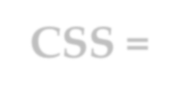
CSS =
Cascading Style Sheet

Slide 14

CSS
Set of rules defining how an html element will be “presented” in the browser.

Slide 15


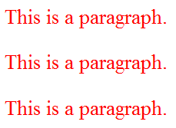
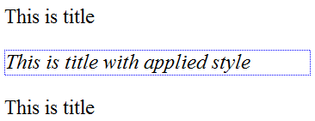
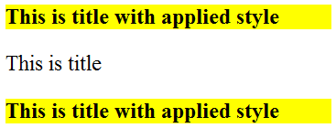
CSS Rules
p {
color: red;
}
#title {
font-style: italic; border: 1px dotted blue;
}
.title {
font-weight: bold; background: yellow;
}

Slide 16
Some things you can change with CSS
colors
font
font size
backgrounds
spacing
sizes
borders
positions (layout)

Slide 17



Some things you can’t
change with CSS
content
markup

Slide 18


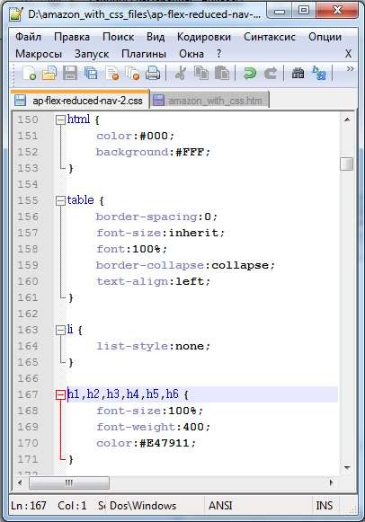
So now it’s time for styling!!!
Lets add some css rules to our example page.

Slide 19


How will it look now???

Slide 20
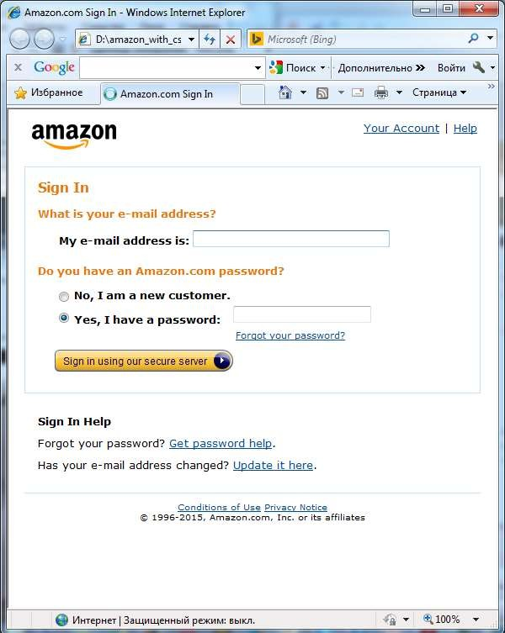

Looks perfect!

Slide 21


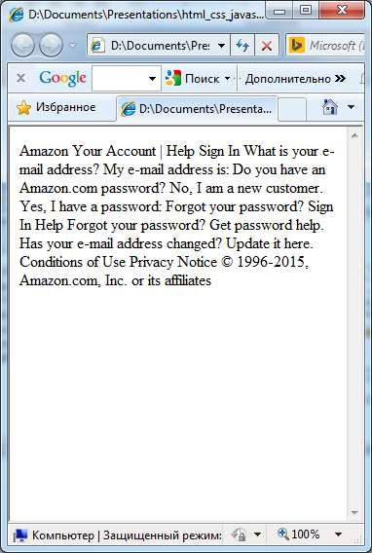
Text
+ HTML
+ CSS
= Web Page

Slide 22

Now time for actions!
JavaScript

Slide 23












JavaScript ≠ Java
(c) Jeremy Keith, web developer, 2009

Slide 24
JavaScript ≠ Java
JavaScript is NOT a Java
It is NOT a light version of Java
It was NOT based on Java
It does NOT matter if you know Java

Slide 25




JavaScript
Classic JavaScript is a client-side language used to add interactivity to your web-pages
Web Browser
Web Page
JavaScript

Slide 26


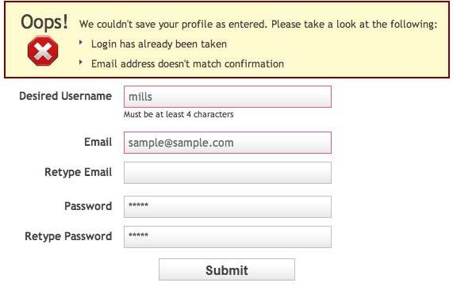
What we can do with JavaScript?
Validate values entered in the form fields

Slide 27
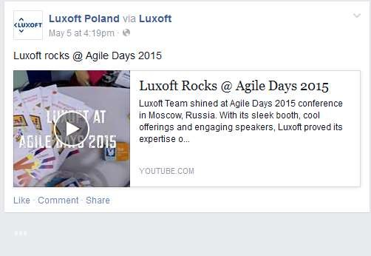
What we can do with JavaScript?
Load information automatically when it's needed

Slide 28
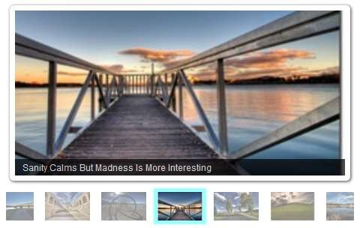
What we can do with JavaScript?
Create photo slideshow and control how long it takes to move from one image to the next and with what animation effect

Slide 29
What we can do with JavaScript?
And much much more…

Slide 30


JavaScript
At the beginning JavaScript was designed to manipulate web pages.
And it does that very well!
But nowadays its usage is much much wider: you can use it outside of web pages and the browser

Slide 31
YOUR DOUBTS AND QUESTIONS ARE WELCOMED

